Slide 1

Havmo
Root Cause Analysis for Product Return Rate Increase

Slide 2
Problem Statement
Problem Statement: Returns have suddenly increased for operations in India
Hypotheses Tested:
Seasonality caused this increase
This spike can be attributed to one product category
The addition of new products within our category are responsible for this increase

Slide 3
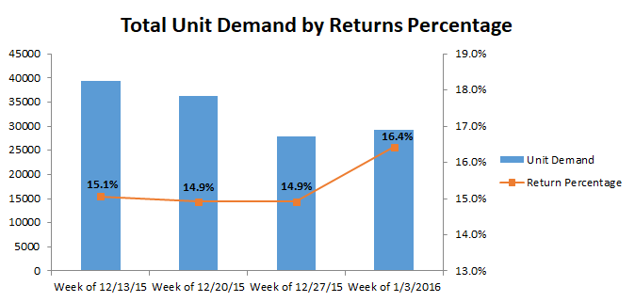
Hypothesis: Seasonality
Seasonality does not appear to be a factor as the return percentage increased even though demand did not.

Slide 4
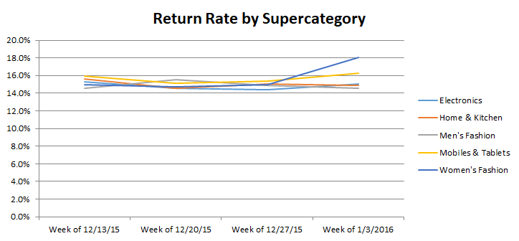
Hypothesis: Product Category
The Women’s Fashion category is the primary contributor to increased returns percentage

Slide 5
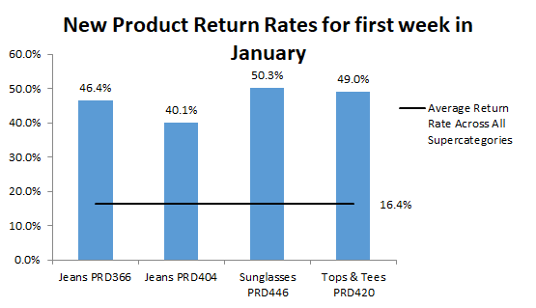
Hypothesis: New Products
Within Women’s Fashion, we’ve pinpointed this increase to 4 newly released products

Slide 6
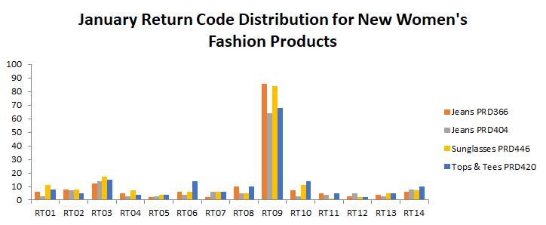
Root Cause: Return Reasons for New Products
RT09: “Wrong item was sent” is the primary reason behind return of our new products

Slide 7
Recommendations
Investigate further with field staff and delivery system to understand why wrong item is being sent for new products
Potential Causes:
Staff training inadequate (discernment of new items; not prepared for introduction of new products)
Delivery system (new products being handled/stored in a different way from usual; system poorly designed to accommodate new items)

